Slide 1


TECHNOVISION 2K26
Automated Data Visualization
System Using Prompt
Department of Artificial Intelligence and Data Science
TEAM MEMBERS
PROJECT GUIDE
1. Geethan S
22UAD032
2. Vijay Chidhambaranathan A
22UAD042
3. Sam Salvius
22UAD002
Dr. Balaji S.
Professor / ADS
1

Slide 2
Motivation for the Project
The motivation behind developing the Automated Data Visualization System Using Prompt arises from the significant challenges that business analysts, domain experts, students, and non-technical users face when attempting to derive meaningful insights from raw datasets. In the modern data-driven landscape, organizations generate vast quantities of structured data on a daily basis; however, the tools currently available for transforming this data into actionable visual intelligence often impose substantial technical barriers that limit their accessibility to a broad user base.
Conventional Business Intelligence platforms such as Microsoft Power BI, Tableau, and Google Looker Studio require users to possess specialized knowledge of data modeling, chart configuration, query construction, and dashboard design.
With the rapid advancement of Natural Language Processing and Large Language Models, it is now feasible to construct intelligent systems that can interpret human-readable prompts and automatically translate them into appropriate data visualizations. This project is motivated by the pressing need to democratize data analytics — to create a system that removes the traditional technical barrier between raw data and its visual representation, and enables any user, regardless of their programming background, to interact with and understand their data through simple, natural language instructions.
2

Slide 3
Project Proposal Document
Project Description
The Automated Data Visualization System Using Prompt is an AI-powered web application that enables users to upload structured datasets (CSV or Excel) and generate meaningful charts and analytical insights through plain English prompts. The system accepts a natural language query such as "Show me monthly sales by city in a bar chart," processes it using the Google Gemini Large Language Model, identifies the visualization intent, selects the most appropriate chart type, applies the necessary data aggregation and transformation using Pandas and NumPy, and renders the resulting interactive visualization on a React.js dashboard. The system also performs automated data quality assessment, provides AI-generated insights, and allows users to export analysis reports — all without requiring any programming or BI tool expertise.
Project Objective
To enable non-technical users to generate charts from datasets using plain English prompts. To integrate Google Gemini LLM for automatic visualization intent detection and chart type selection. To implement automated data quality assessment, cleaning, and transformation as a pipeline. To deliver an interactive, browser-based dashboard with downloadable chart and report export.
Innovation
Natural language prompt as the sole interaction interface, replacing manual chart configuration. Real-time AI-generated textual insights alongside every chart visualization. Automated data quality scoring (completeness, consistency, structure) at upload time.
3

Slide 4
Literature Survey (Maximum of 1 slide)
S.No | Author Name | Journal / Conference | Title of the Paper | Year | Inference
1 | J. Heer & B. Shneiderman | ACM Queue | Interactive Information Visualization: Enabling Analysis and Discovery | 2012 | Established foundational interactive visualization paradigms; manual configuration required, no NLP support.
2 | M. Vartak et al. | VLDB Endowment | SeeDB: Efficient Data-Driven Visualization Recommendations | 2015 | Automated chart recommendation via SQL queries; no natural language interface for non-technical users.
3 | V. Dibia & C. Demiralp | IEEE CG&A | Data2Vis: Automatic Generation of Visualizations using Sequence to Sequence Models | 2019 | Neural seq2seq model for NL-to-chart; limited to structured query types with ~75% accuracy.
4 | A. Narechania et al. | IEEE TVCG | NL4DV: A Toolkit for Generating Analytic Specifications from Natural Language Queries | 2021 | NLP toolkit for NL-to-visualization; rule-based entity extraction limits performance on complex prompts.
5 | X. Li et al. | ACM CIKM | LLM-Driven Automated Analytics: From Query to Insight | 2023 | LLM-based automated analytics with 91% accuracy; requires cloud GPU infrastructure for deployment.
4

Slide 5
Design Document
Work Breakdown Structure
Sl. No. | Nature of Work | Duration
1. | Requirement analysis, literature survey, and system design planning | 1 week
2. | Dataset collection, data preprocessing, and quality assessment module development | 1.5 weeks
3. | NLP engine integration (Google Gemini API) and prompt processing logic | 2 weeks
4. | FastAPI backend development, chart generation logic, and database integration | 3 weeks
5. | React.js frontend dashboard, Chart.js visualization rendering, and UI/UX design | 2 weeks
6. | System testing, performance evaluation, report export module, and documentation | 2 weeks
A. Development Plan — Deliverable
The project will deliver an AI-powered web application (DataNova) that enables any user to upload a CSV or Excel dataset and generate interactive visualizations through natural language prompts. The deliverable includes a FastAPI backend, a Google Gemini-powered NLP engine, an automated data quality assessment module, a React.js dashboard with Chart.js rendering, and a downloadable analysis report export feature.
5

Slide 6
GANTT CHART
Activities | W1 | W2 | W3 | W4 | W5 | W6 | W7 | W8 | W9 | W10 | W11 | W12
Requirement Analysis & Literature Survey | ▌ | ▌
Dataset Collection & Data Preprocessing |  | ▌ | ▌
NLP Engine Integration (Gemini API) |  |  | ▌ | ▌
FastAPI Backend & Chart Generation Logic |  |  |  | ▌ | ▌ | ▌
React.js Frontend & Dashboard Development |  |  |  |  |  | ▌ | ▌ | ▌
Testing, Performance Evaluation & Report Export |  |  |  |  |  |  |  | ▌ | ▌ | ▌
Documentation & Final Report |  |  |  |  |  |  |  |  |  | ▌ | ▌ | ▌
Completed
Planned
6

Slide 7
B. Design — Project Requirements
Sl. No. | Requirements
1 | To develop an AI-powered web application that allows any user, regardless of technical background, to upload a CSV or Excel dataset and generate interactive data visualizations through natural language prompts, without requiring programming or BI tool expertise.
2 | To integrate a Google Gemini Large Language Model that interprets the user's plain English prompt in the context of the dataset schema and automatically selects the most appropriate chart type, column mappings, and aggregation function.
3 | To implement an automated data quality assessment and cleaning pipeline that detects missing values, type inconsistencies, and duplicate records, and reports a composite quality score upon dataset upload.
4 | To build a FastAPI backend providing scalable REST API endpoints for dataset ingestion, NLP query processing, chart generation logic, and analysis report export.
5 | To deliver an interactive React.js frontend dashboard supporting bar, line, pie, scatter, and histogram chart types with real-time rendering via Chart.js and individual chart download capability.
7

Slide 8
System Configuration
User Interface
(React.js)
Backend Server
(FastAPI)
Data Processing
(Pandas / NumPy)
NLP Engine
(Gemini AI)
Visualization
Engine (Chart.js)
Prompt Input
Dataset Upload
▶
API Handling
Request Processing
▶
Cleaning
Transformation
▶
Intent Detection
Chart Selection
▶
Chart Rendering
Dashboard
Database (SQLite / PostgreSQL)
Store Data • Store Results
SYSTEM SETUP DIAGRAM — DataNova Automated Visualization Pipeline
8

Slide 9
System Design Description
In the first section, the system collects the user's dataset through the web-based upload interface, where the file is ingested into the FastAPI backend and immediately subjected to automated quality assessment. The Data Processing Module computes the total row and column count, identifies missing values, detects data type inconsistencies, and assigns a composite quality score. The resulting cleaned and validated DataFrame is stored in application memory and made available for all subsequent query operations in the session.
In the second section, the user submits a natural language prompt through the AI Chat interface.The model interprets the analytical intent of the query, selects the most appropriate chart type (bar, line, pie, scatter, or histogram), identifies the columns to be mapped to the chart axes, determines the aggregation function to apply (sum, mean, count, max, or min), and returns a structured JSON visualization specification. The intent validation layer verifies that the specification references columns that exist in the uploaded dataset and that the chart type is supported; if validation fails, a fallback default specification is applied and the user is notified.
Finally, the backend Data Processing Module executes the aggregation specified in the chart configuration — grouping the DataFrame by the designated x-axis column and applying the aggregation function to the y-axis column — and formats the resulting data as a Chart.js-compatible JSON structure. The React.js frontend receives this response, renders the interactive visualization on the dashboard, and simultaneously displays the AI-generated textual explanation of the chart configuration. Users may download individual charts, explore the Dashboard view for automatically generated multi-chart insights, or export the entire analysis session as a structured audit report.
9

Slide 10
C. Acceptance Plan
Req. No. | Requirements | Test
1 | The system should accept a CSV or Excel dataset upload, perform automated quality assessment, and display the quality score, row count, column count, and missing value summary. | Upload the superstore_100.csv file. Verify that the system reports 100 rows, 18 columns, 0 missing values, and a quality score of 95/100 on the Data Vault screen.
2 | The system should process a natural language prompt, identify the correct chart type and column mappings, and render the appropriate interactive visualization. | Submit the prompt 'Show segment distribution as a pie chart.' Verify that the system renders a pie chart with three segments (Corporate, Consumer, Home Office) and the correct proportional values.
3 | The system should automatically generate a dashboard with multiple charts and AI-generated insights for the uploaded dataset without requiring additional user prompts. | Navigate to the Dashboard view after upload. Verify that at least four charts are auto-generated and that the AI Insights panel displays a minimum of five data findings.
4 | The system should allow the user to export the complete analysis session as a downloadable audit report containing all prompts, AI explanations, and chart data. | Click 'Export Audit' after completing three prompt queries. Verify that the downloaded file contains all submitted prompts, the corresponding AI explanations, and the chart data for each visualization generated.
10

Slide 11
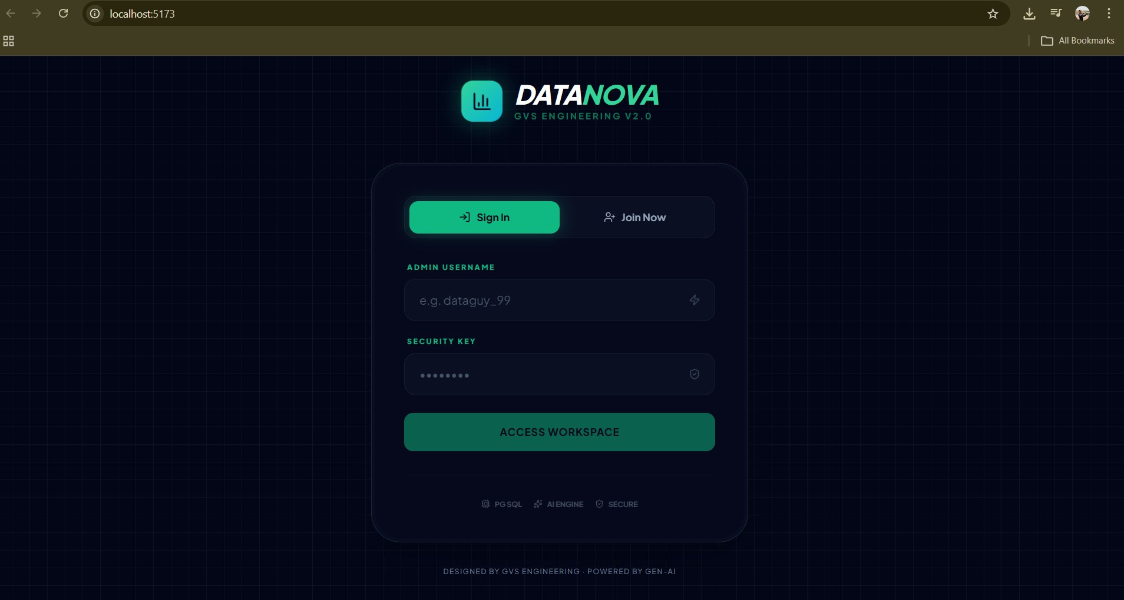
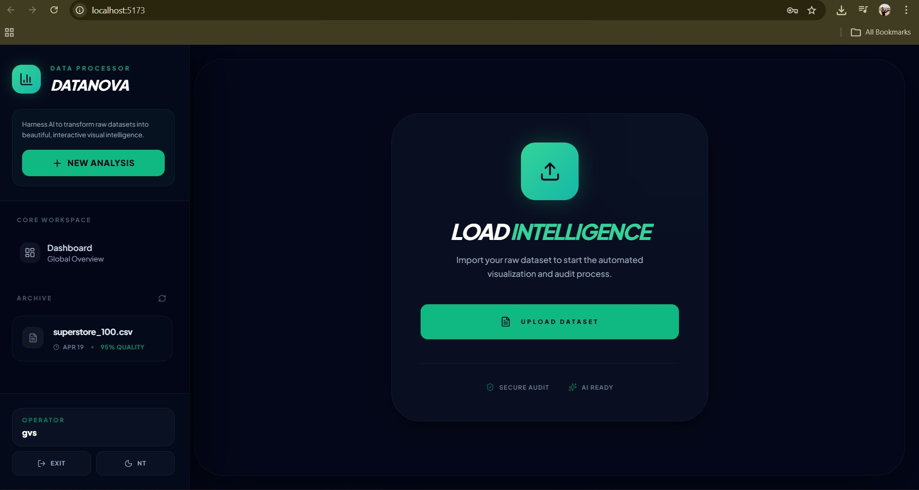
D. Results
Figure 1.1 DataNova Login Interface
Figure 1.2 Dataset Upload — Load Intelligence Screen
Figure 1.1 illustrates the main login interface of the DataNova system. The screen presents a professional dark-themed UI with the DataNova brand identity and GVS Engineering V2.0 designation. Users authenticate using an Admin Username and Security Key combination, after which they are granted access to the workspace. The interface also displays three capability badges — PG SQL, AI Engine, and SECURE — that communicate the system's underlying technical architecture. The login module ensures that each analysis session is authenticated and user-specific, enabling personalized access to the data vault and analysis history.
Figure 1.2 shows the dataset upload module of the DataNova system, referred to as the Load Intelligence interface. After authentication, the user is presented with a prominent 'Upload Dataset' button that initiates the file ingestion process. The left navigation panel displays the Core Workspace sections — Dashboard and Data Vault — and an Archive panel listing previously analyzed datasets with their timestamps and quality scores. This interface design ensures that users can immediately begin a new analysis or revisit historical sessions upon login, minimizing the time from data receipt to visualization.
11

Slide 12
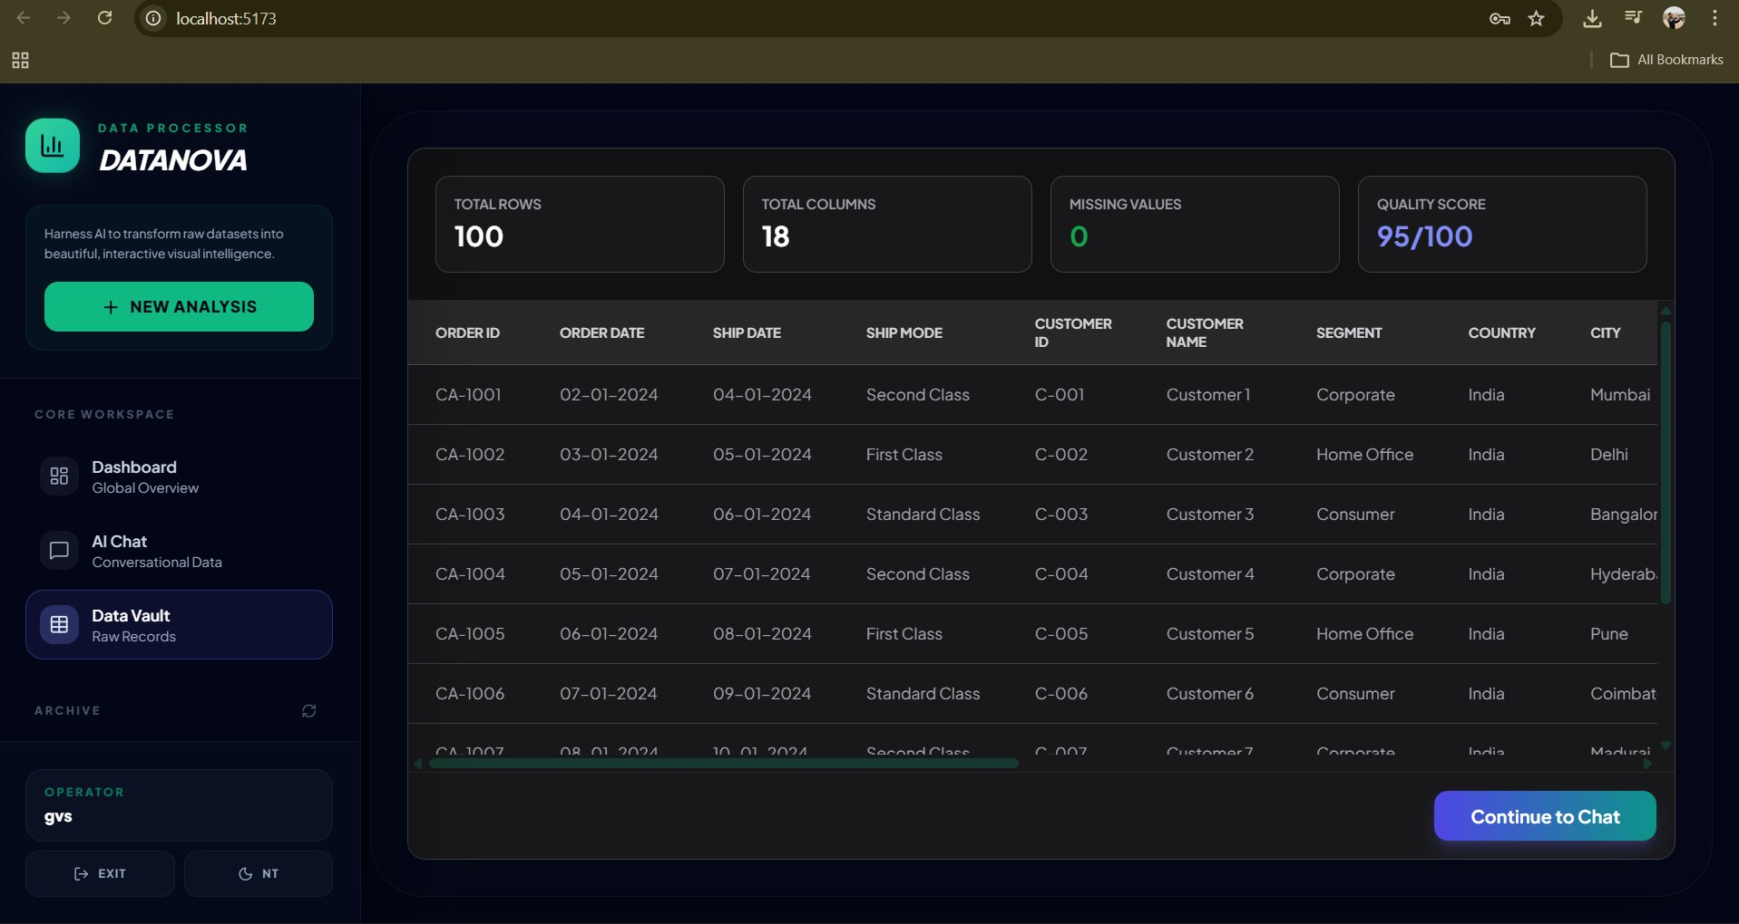
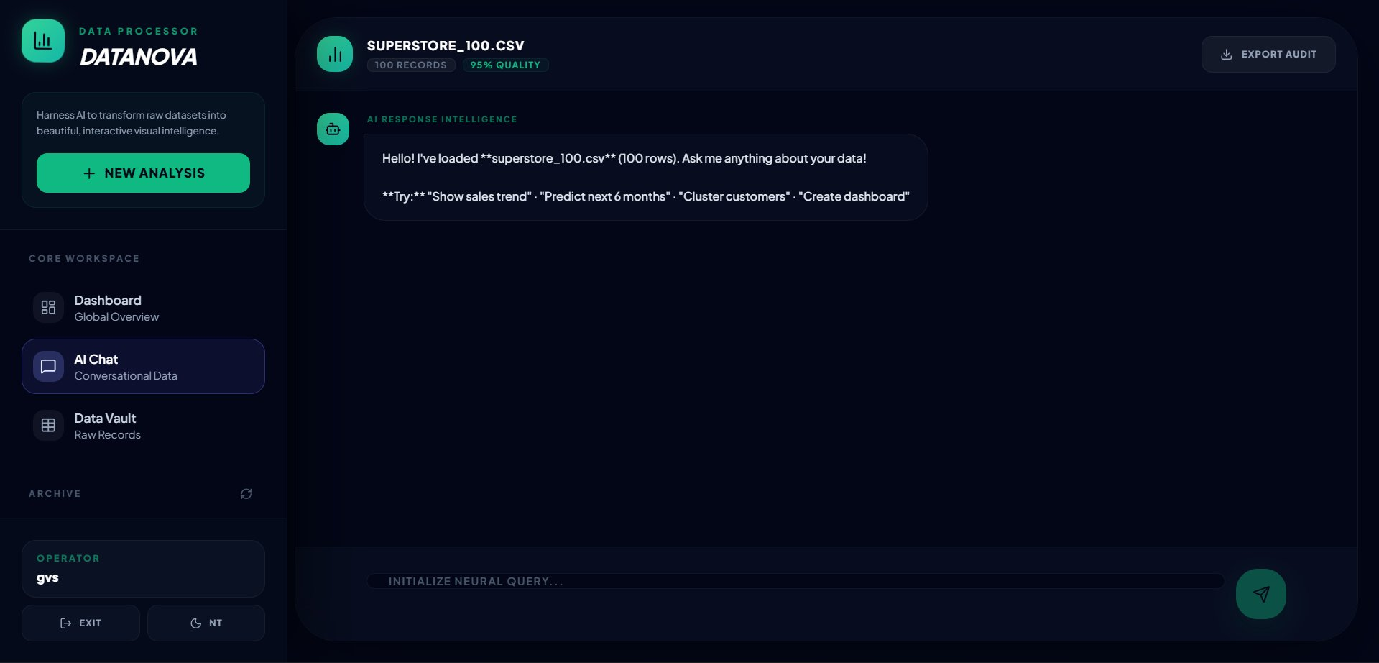
D. Results
Figure 1.3 Data Vault — Dataset Preview and Quality Score
Figure 1.4 AI Chat Interface — Prompt Input and NLP Processing
Figure 1.3 represents the Data Vault interface, which is displayed immediately after a dataset is successfully uploaded and processed. The top panel presents four key quality metrics for the uploaded superstore_100.csv dataset: Total Rows (100), Total Columns (18), Missing Values (0), and Quality Score (95/100). The tabular preview beneath these metrics shows the first rows of the dataset with all 18 column headers visible, enabling the user to verify the data structure before proceeding to analysis. The zero missing-value count and the 95/100 quality score confirm that the automated data quality assessment pipeline has correctly evaluated the integrity of the uploaded dataset.
Figure 1.4 shows the AI Chat interface of the DataNova system, which serves as the primary interaction surface for prompt-based data analysis. The system displays a welcome message confirming that the dataset has been loaded (100 rows, 95% quality) and provides suggested example queries to guide new users. The interface features a neural query input field at the bottom, an Export Audit button in the top-right corner for session export, and the dataset header showing the filename and quality badges. This design positions the natural language prompt as the central interaction modality, replacing the complex chart configuration workflows of traditional BI tools.
12

Slide 13
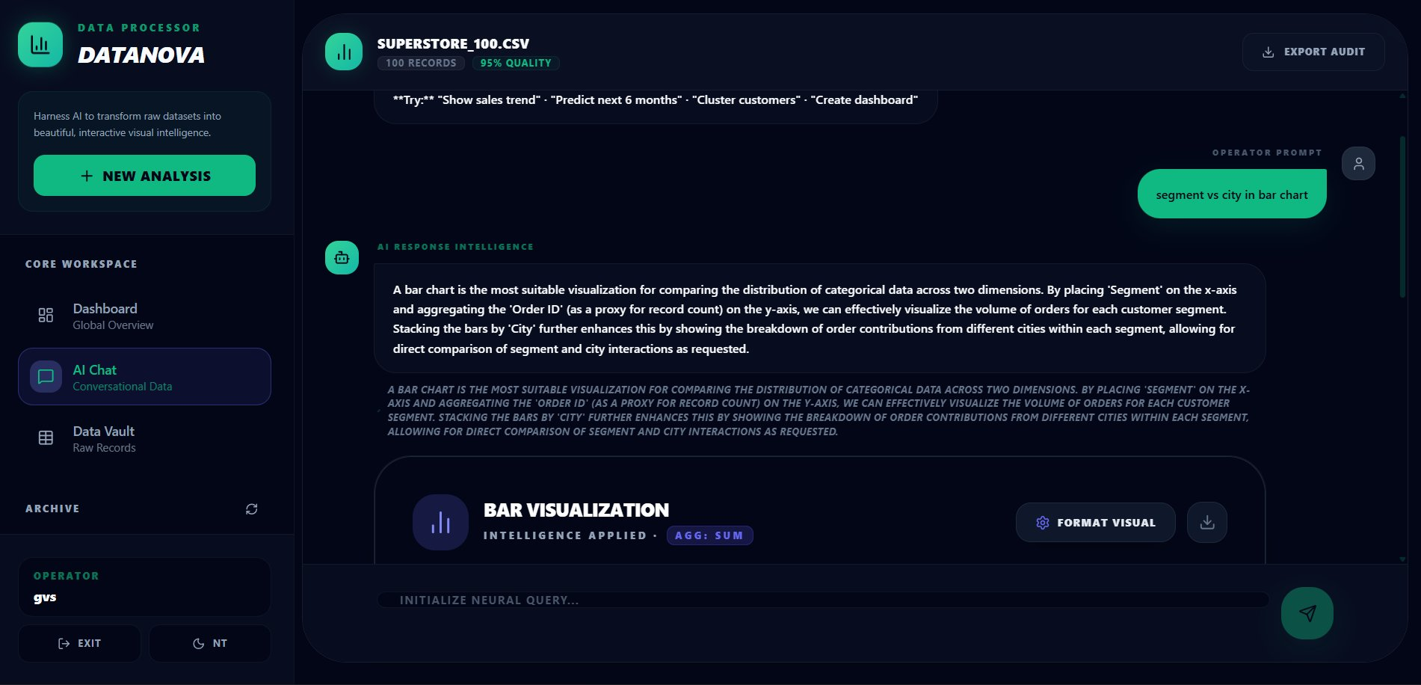
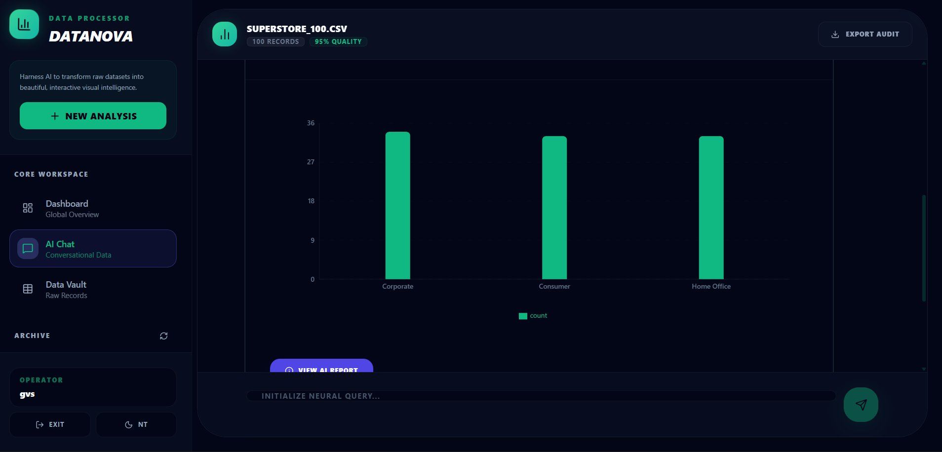
D. Results
Figure 1.5 NLP-Generated Bar Chart with AI Explanation
Figure 1.6 Dashboard Global Overview with Auto-Generated Charts and AI Insights
Figure 1.5 illustrates the complete NLP query processing and chart generation pipeline. The user submits the prompt 'segment vs city in bar chart,' and the Gemini AI model processes this query in the context of the dataset schema. The AI Response Intelligence panel displays the model's reasoning: a bar chart is selected as the most suitable visualization for comparing categorical data across two dimensions, with Segment placed on the x-axis and Order ID count aggregated on the y-axis.
Figure 1.6 shows the DataNova Dashboard — the Global Overview interface that automatically generates a comprehensive analytics view for the uploaded dataset without requiring any user prompts. The header displays the dataset name and a summary tagline. Four metric cards present Rows (100), Columns (18), Charts (4), and Insights (5).
13

Slide 14
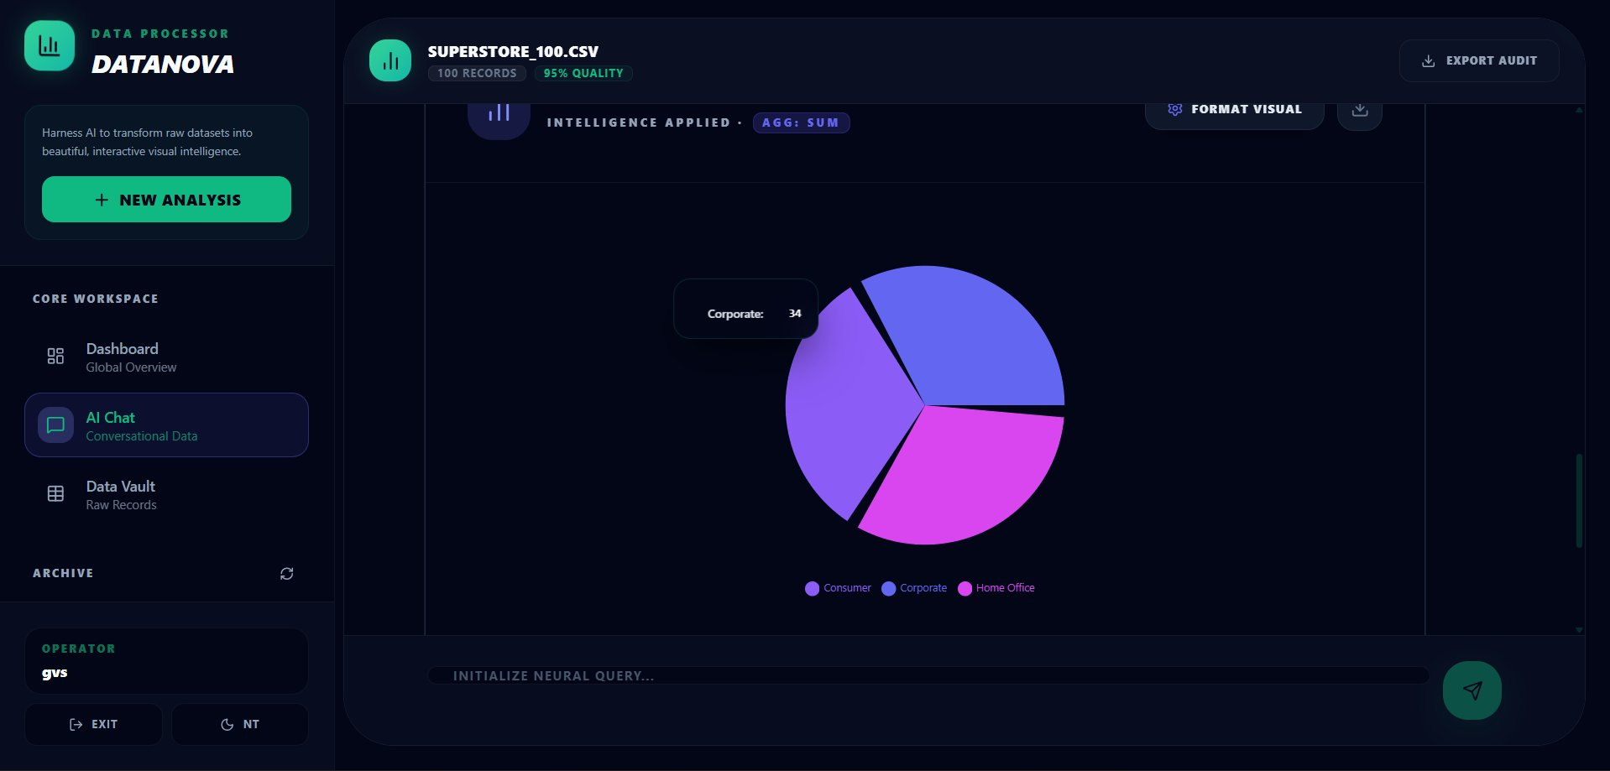
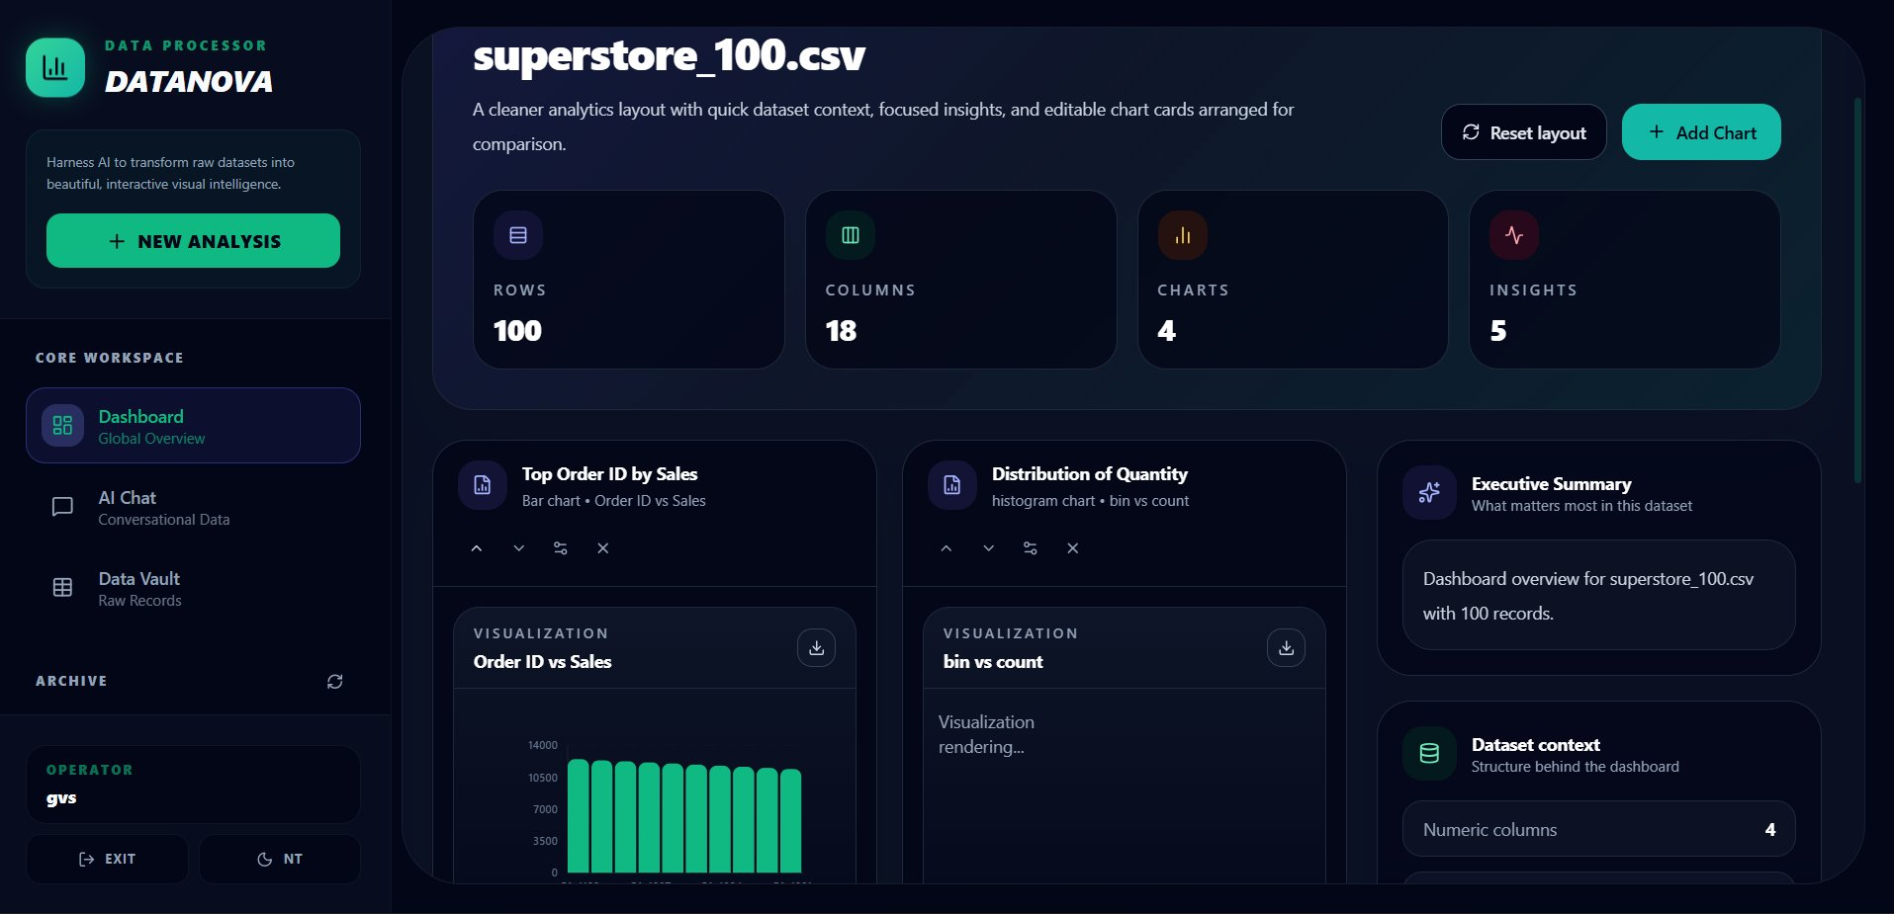
D. Results (Continued)
Figure 1.7 Generated Bar Chart — Segment Distribution
Figure 1.8 Generated Pie Chart — Segment Breakdown
Figure 1.7 shows the bar chart output for the segment analysis query. Three bars represent Corporate, Consumer, and Home Office segments, each recording approximately 33–35 orders — confirming near-uniform distribution. The NLP engine correctly identified Segment as the grouping variable and applied a count aggregation.
Figure 1.8 illustrates the pie chart for a segment composition query. The three segments are rendered with gradient colors and hover tooltips showing exact counts. The Corporate slice (34 records) is consistent with the bar chart, confirming data accuracy across different chart types.
14

Slide 15
References
[1] J. Heer and B. Shneiderman, "Interactive Dynamics for Visual Analysis," ACM Queue, vol. 10, no. 2, pp. 30–55, 2012.
[2] M. Vartak, H. Rahman, S. Madden, A. Parameswaran, and N. Polyzotis, "SeeDB: Efficient Data-Driven Visualization Recommendations to Support Visual Analytics," VLDB Endowment, vol. 8, no. 13, pp. 2182–2193, 2015.
[3] V. Dibia and C. Demiralp, "Data2Vis: Automatic Generation of Data Visualizations Using Sequence to Sequence Recurrent Neural Networks," IEEE Computer Graphics and Applications, vol. 39, no. 5, pp. 33–46, 2019.
[4] A. Narechania, A. Srinivasan, and J. Stasko, "NL4DV: A Toolkit for Generating Analytic Specifications for Data Visualization from Natural Language Queries," IEEE TVCG, vol. 27, no. 2, pp. 369–379, 2021.
[5] X. Li, J. Wang, and Z. Zhang, "LLM-Driven Automated Analytics: From Query to Insight," ACM CIKM, pp. 3201–3210, 2023.
[6] Geethan, Vijay Chidhambaranathan, and Sam Salvius, "Automated Data Analytics and Visualization System using Prompts," IJEETR, vol. 8, no. 2, March–April 2026.
[7] A. Satyanarayan, D. Moritz, K. Wongsuphasawat, and J. Heer, "Vega-Lite: A Grammar of Interactive Graphics," IEEE TVCG, vol. 23, no. 1, pp. 341–350, 2017.
15

Slide 16
Video Link
▶
[ https://drive.google.com/file/d/1Ctjuqo4K16bN5o5-yztBGYIeRtl3x5yt/view?usp=drive_link ]
GitHub Repository: https://github.com/Geethan1820/Automated-Data-Visualization-using-prompt
16

